Slide 1
PowerShell Scripting
Cybersecurity
Lesson 7.2

Slide 2

Learning Objectives
By the end of today’s class, you will be able to:
1
Use basic PowerShell cmdlets to navigate Windows and manage directories and files.
2
Use PowerShell pipelines to retrieve Windows system event logs.
3
Combine various shell-scripting concepts such as cmdlets, parameters, conditions, and importing files with defined data structures.

Slide 4

Recap
In the last class, we discussed:
1
Auditing processes
5
Enumerating local policies
2
Using CMD to create files
6
Creating users with policies
3
Windows Users
7
Task Scheduler
4
Auditing unwanted apps

Slide 5

What is PowerShell?

Slide 6
PowerShell is a powerful scripting language we can use to locally and remotely manage Microsoft’s line of products.

Slide 7

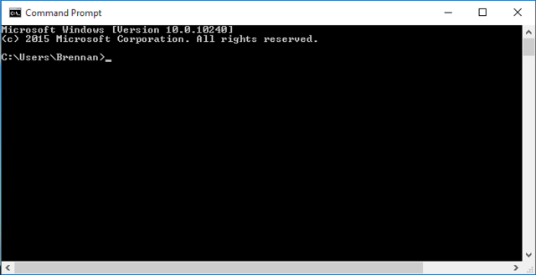
CMD
PowerShell
Commands are short and simple, designed for repeatable tasks.
Powerful language used to execute, automate, and customize tasks.

Slide 8

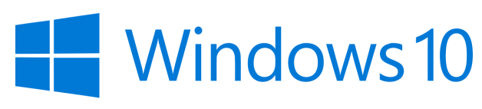


PowerShell in System Administration
PowerShell can be used to manage everything in a Microsoft environment.
Windows Server: Microsoft’s central server for domain and networking services.
Windows 10: Microsoft’s personal and professional computer operating system, the operating system used by most people and within many large enterprise environments.
Office365: Microsoft's line of subscription office services, such as Microsoft Word or Excel.
Azure: Microsoft’s cloud services, such as virtual private clouds and cloud-based VMs.

Slide 9


PowerShell in Cybersecurity
Defensive Cybersecurity
Manage and audit logs
Harden hosts and servers
Extended module and script functionality

Slide 10
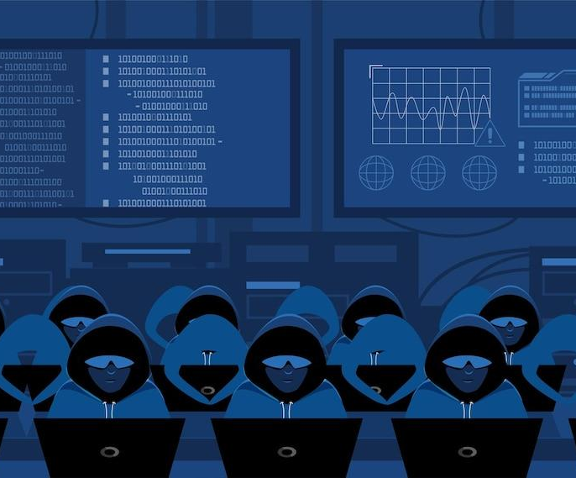

PowerShell in Cybersecurity
Offensive Cybersecurity
“Living off the land” tool
Enumerate systems on a network
Access other network machines

Slide 11

PowerShell vs. CMD

Slide 12
PowerShell vs. CMD
CMD’s functionality is limited.
CMD output is only available in
simple text format.
For unsupported file formats, we need to edit the output with meticulous character replacing.
CMD command flags can be ambiguous, confusing, and specific to each command:
/s flags:
shutdown /s shuts down a computer.
freedisk /s specifies the name of an IP or remote computer to check disk space.
/d flags:
shutdown /d specifies a reason for shut down.
freedisk /d specifies which disk drive to check.

Slide 13
PowerShell provides
clearly defined, universal parameters for commands.

Slide 14
PowerShell vs. CMD
Based on the language used in the following commands, what do you think they will do?
PS C:\Users\administrator> Stop-Computer -Confirm
PS C:\Users\administrator> Stop-Computer -Force

Slide 15
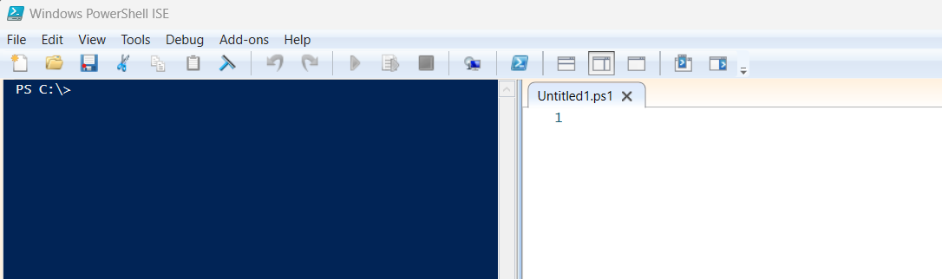
PowerShell Integrated Scripting Environment (ISE)
Graphical host application for PowerShell
Script editor
Syntax coloring
Integrated help
Add-ons
Command pane
Tab completion
Debugging tools

Slide 16
We can use PowerShell piping for operations that CMD doesn’t support.

Slide 17
PowerShell Piping for CMD’s Unsupported Operations
To find the file sizes of subdirectories in C:\Windows\Systems in CMD, we must use a complex batch file consisting of the following:
@echo off
set size=0
for /r %%x in (System\*) do set /a size+=%%~zx
echo %size% Bytes
PowerShell can do this with a simple pipe ( | ):
dir C:\Windows\System -Recurse | Measure-Object -Sum Length
Grabs all the current directory and subdirectory contents.
The output is piped into this command, which measures files.

Slide 18
PowerShell Piping for CMD’s Unsupported Operations
To find the file sizes of subdirectories in C:\Windows\Systems in CMD, we must use a complex batch file consisting of the following:
@echo off
set size=0
for /r %%x in (System\*) do set /a size+=%%~zx
echo %size% Bytes
PowerShell can do this with a simple pipe ( | ):
Objects are a very important PowerShell concept. We’ll look at them next.
dir C:\Windows\System -Recurse | Measure-Object -Sum Length

Slide 19
“Objects” are Microsoft’s
name for every component
in a system that PowerShell recognizes and interacts with.

Slide 20
PowerShell and Objects Demo

Slide 22

Intro to PowerShell

Slide 23


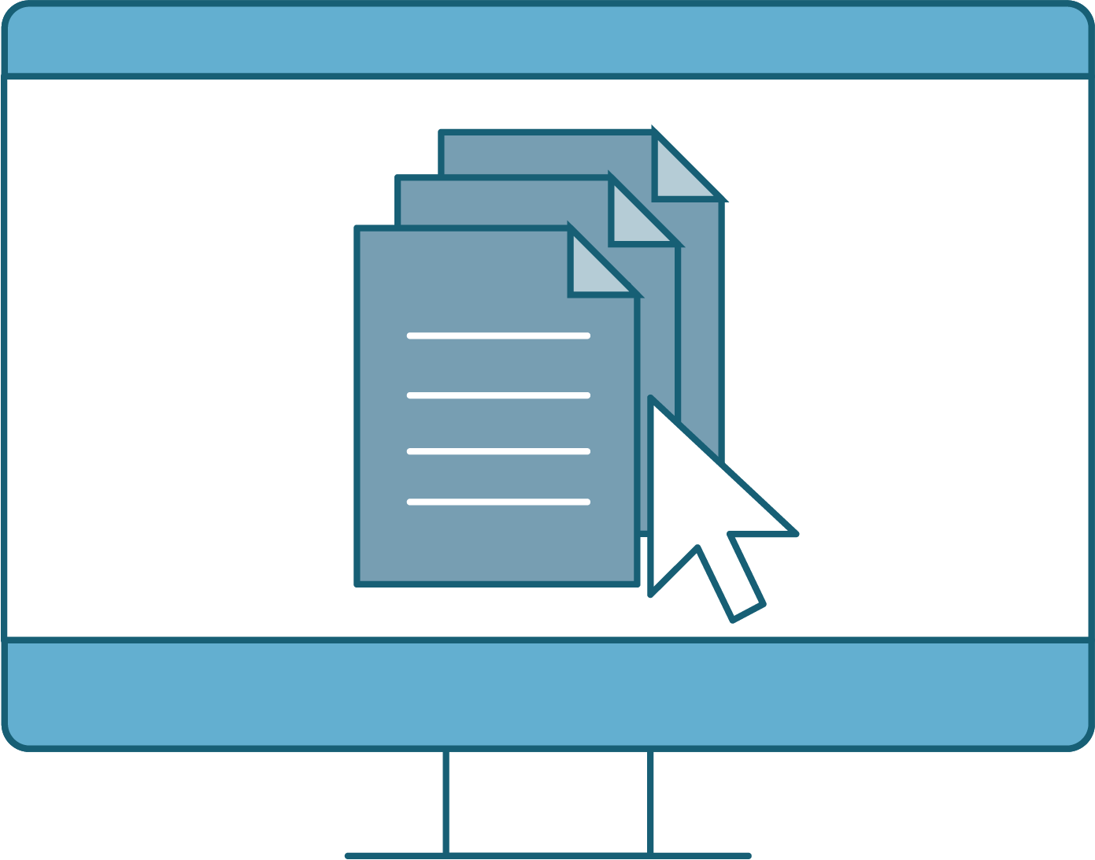
Demonstration Scenario
Let’s continue our scenario from the previous lesson
Throughout today’s lesson, we will be working with PowerShell to complete the following activities for our CIO:
Navigate Windows with the PowerShell command line.
  Create logs with PowerShell.
  Create scripts with PowerShell.
Notes:
shutterstock_1888488028

Slide 24
PowerShell Syntax
cmdlets
PowerShell uses commands known as cmdlets (“command-lets”)
Combination of verbs and nouns
Measure-Object
Verb
Noun

Slide 25
PowerShell Commands
cmdlet | Function | Equivalent Command
Set-Location | Changes to specified directory | cd
Get-ChildItem | Returns current directory contents | ls, dir
New-Item | Makes new file or directory | mkdir, touch
Remove-Item | Deletes file or directory | rm, rmdir
Get-Location | Retrieves path to current directory | pwd
Get-Content | Returns file content | cat, type
Copy-Item | Copies a file from one location to another | cp
Move-Item | Moves item from one location to another | mv
Write-Output | Prints output | echo
Get-Alias | Shows aliases from the current session | alias
Get-Help | Retrieves information about command | man
Get-Process | Retrieves processes running on machine | ps
Stop-Process | Stops specific process | kill
Get-Service | Retrieves list of services | service --status-all

Slide 26

Verbs-Nouns
Consider the following scenario:
User Alex left the company.
We want to remove their user account from the system, but we want to keep the reports they were working on.
We need to move the reports’ files from their user desktop directory to
a directory outside of the user.
Along the way, we'll explore some other useful PowerShell commands.
We’ll use the following commands:
Set-Location Move-Item Get-ChildItem New-Item Remove-Item

Slide 27
PowerShell Verb-Noun Demo

Slide 28
Now, we’ll use parameters
to customize the commands.

Slide 29
Parameters
Instead of using New-Item to create another file, we can add parameters to the New-Item command and create a directory, with a specific name and location:
We can use a pipe to retrieve only objects containing the word “system”:
New-Item -Path "C:\" -Name "Logs" -ItemType "Directory"
-Path: Parameter specifying the location of this new directory.
-Name: Parameter specifying the directory’s name.
-ItemType: Parameter specifying the type of item we want to create.
If we don’t specify "Directory", it will default to a file.

Slide 30
Parameter Examples

Slide 31
Move and Create Directories
In this activity, you will work as a junior system administrator tasked with vetting a process to create Windows Event logs. These logs will later be integrated into a log management program known as a SIEM.
You’ll run PowerShell commands to create, rename, and move items.
10 minutes

Slide 34

Generating Windows Event Log Files with Parameters and Pipelines

Slide 35
Chaining commands is important in system administration and security roles.

Slide 36
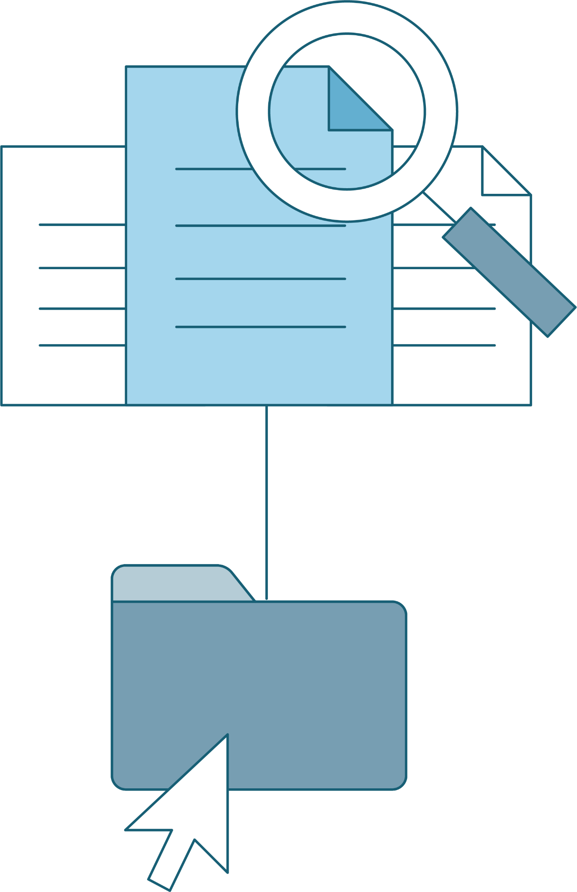
Demonstration Scenario
We will continue our role as a junior system administrator. Our CIO has asked us to retrieve logs and save them as JSON files in our newly created C:\Logs directory. Chain cmdlets together that:
Retrieve Windows logs from Windows Events.
Transform the logs to the structured data format JSON.
Output these files to the C:\Logs directory we made in the last activity.
Notes:
shutterstock_1888488028

Slide 37
PowerShell Parameters

Slide 38

Piping Logs to JavaScript Object Notation
ConvertTo-Json
Now that we used parameters to get the logs we need, we will output them into a file that can be used later by log analysis applications.
This is where pipelines come in:
JSON (JavaScript Object Notation) structured data format can be easily read and manipulated by today's most common scripting and programming languages.
Get-WinEvent -LogName System -MaxEvents 10 | ConvertTo-Json

Slide 39
Piping Logs to JSON

Slide 41
Generating Windows Event Log Files with Parameters and Pipelines
In this activity, you will play the role of a Windows system administrator.
You've been asked to create and save logs to the directory C:\Logs.
These logs can then be sent to security analysts for examination in a Security Information and Event Management System (SIEM), which we will explore in depth during a later lesson.
20 Minutes

Slide 45
Scripting with PowerShell

Slide 46

The Importance of Scripting (Again)
We’ve emphasized the importance and convenience of scripting in our past sysadmin units.
Scripts allow sysadmins and security professionals to automate and execute basic to advanced procedures and operations.
Scripts can be used for everything from setting basic firewall rules to standing up entire cloud virtual machine environments with networking, storage, and users.

Slide 47


The Importance of Scripting (Again)
Scripting allows sysadmins and security professionals the ability to execute basic and advanced procedures:
Firewall rules
Cloud management
Networking
Storage
Users

Slide 48

Scripting with PowerShell
Scripting commands in sequence
For example, you were asked to set up Windows workstations for users in the accounting department. You could create a script to:
01
Pull sensitive files to a specified directory
02
Download AppLocker
Deploy application policies for AppLocker, restricting user access for only people in the accounting group
03

Slide 49
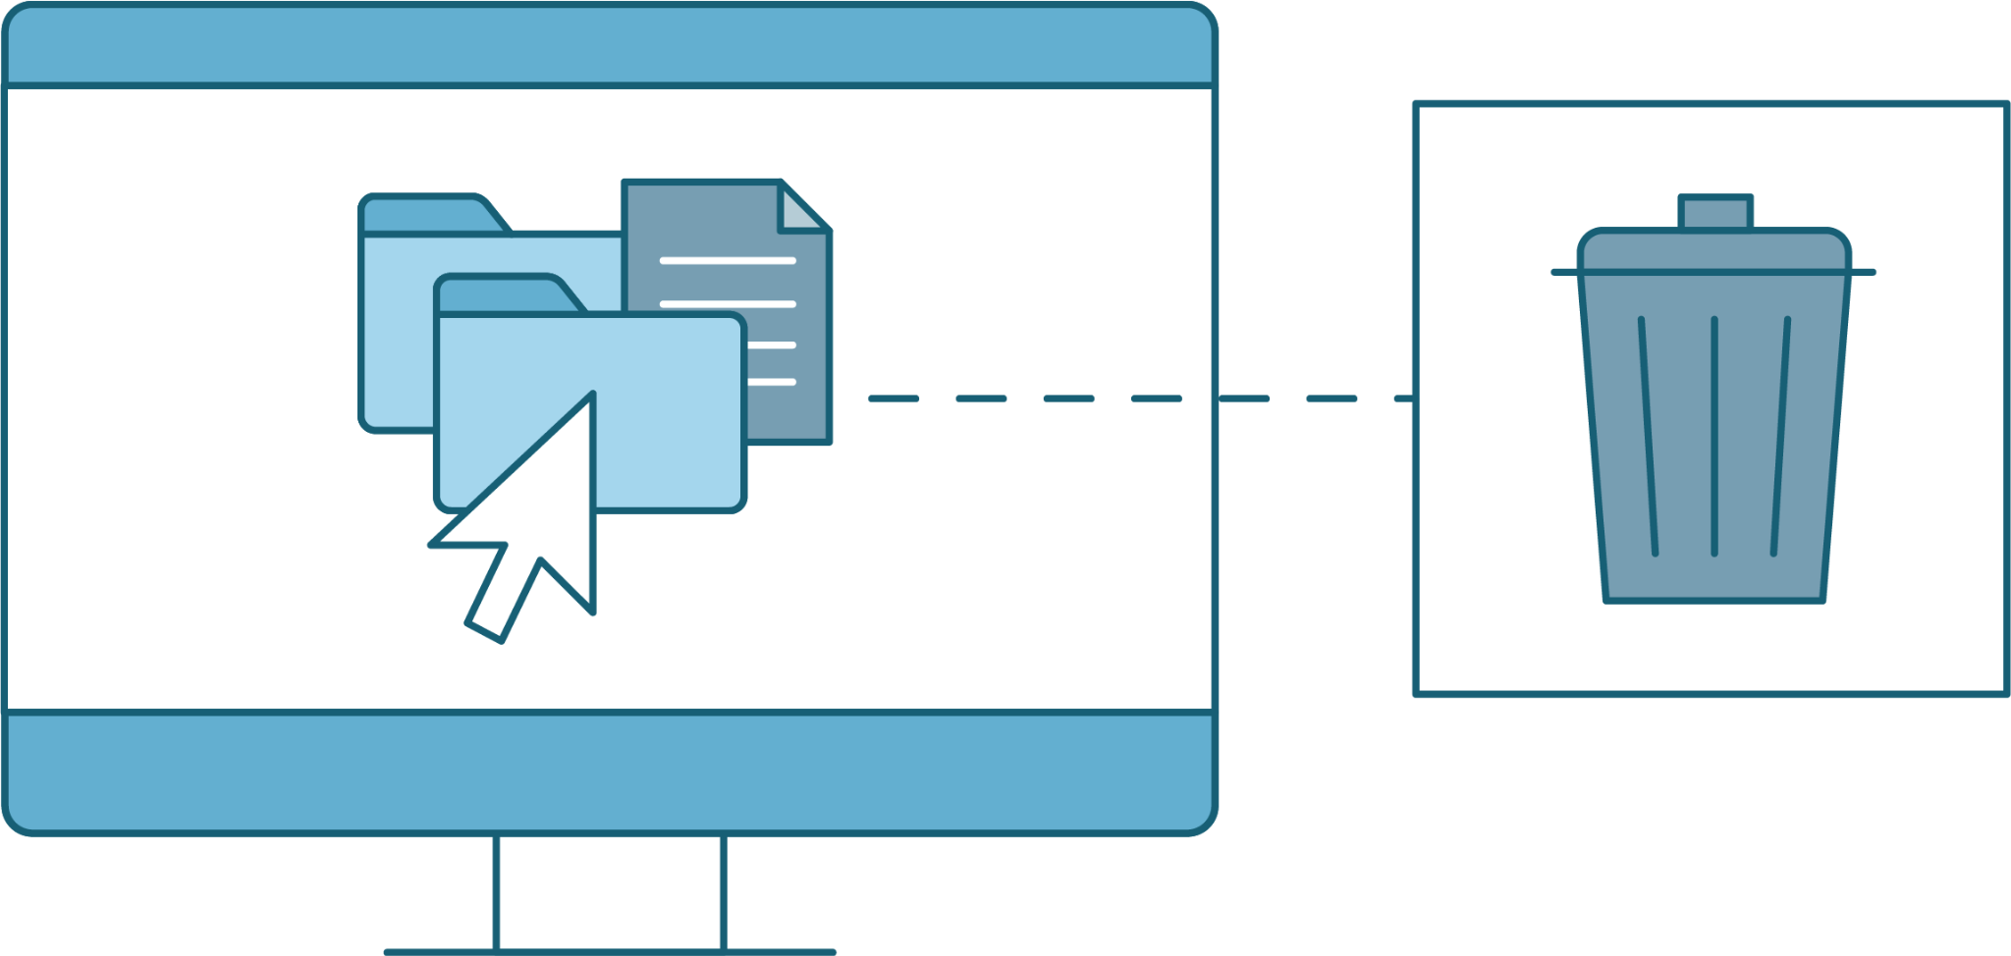
Demonstration Scenario
Scripting the Removal of Unnecessary Packages
In the upcoming demo, we will create a script in Git-Bash Nano to remove Microsoft Skype.
This Windows workstation has installed a bunch of applications that are largely unnecessary and potential vectors of attack.
These settings include telemetry tracking and advertising IDs, and default installed applications, including Skype.
We want to remove these applications to reduce the attack surface area for this workstation.
Notes:
shutterstock_1888488028

Slide 50

Demonstration Scenario
By default, PowerShell does not allow scripts to run.
This is to prevent malware, attackers, and misconfigured scripts compromising a system.
Our systems have been configured
to allow scripts to run, allowing automation.
Notes:
shutterstock_1888488028

Slide 51


Demonstration Scenario
In the demo, we’ve been tasked to:
Use a foreach loop
Use a cmdlet to import various items
Create a PowerShell script file and execute it
Notes:
shutterstock_1888488028

Slide 52
Creating and Executing a PowerShell Script to Remove Applications

Slide 53

PowerShell Scripts and Removing Skype
We’ve just deleted a useless app from our machine.
While we could remove the Windows Store apps one by one, it would be more efficient to create a script that loops through a list of the apps and uninstalls them all at once.
More specifically, we can loop through comma-separated values (CSV) files.

Slide 54
Comma-separated values (CSV) files are plain text files that contain simply structured data, or fields, separated by commas.

Slide 55
CSV Files
CSV files contain structured lines of information made up of rows of data.
Top line contains the header, describing each field.
Fruit,Vegetable
"Apple","Carrot"
"Banana","Broccoli"
"Orange","Spinach"
"Grapes","Peas"
"Strawberry","Cucumber"

Slide 56

CSV Files
System Administrators and Security Professionals often use CSV files.
System Administrators
Usernames
Email addresses
Penetration Tester
IP addresses
Domains/subdomains

Slide 57
foreach Loops
We can use foreach loops to iterate through these files’ items.
The foreach loop in PowerShell is similar to the for loop in Linux, but it is mainly used for looping through files or read-only structured data that you need to loop through.
Fruit | Vegetable
Apple | Carrot
Banana | Broccoli
Orange | Spinach

Slide 58
foreach Loops and CSV Files
Sysadmins and security professionals will use CSV and foreach loops together:
A system administrator may use
a CSV file to maintain a list of employee email addresses
and usernames.
They can use a foreach loop
to loop through each item
and change the passwords.
A penetration tester might
have a list of IP addresses
and corresponding domain and subdomain names to use in a test.
They can use a foreach loop to
try out each password with
a known username.

Slide 59

Now, We Will Continue our Demo Scenario
We will use the Import-Csv PowerShell cmdlet to source the CSV file demo.csv to run with a demo PowerShell script.
If the CSV file is constructed with the standard header and record setup, Import-Csv will prepare the fields to be called by PowerShell.

Slide 60
Import-CSV with a foreach Loop

Slide 61
Removing Unnecessary Packages with PowerShell
In this activity, we will be continuing the role of junior system administrator.
The CIO has tasked us with creating a PowerShell script that will get rid of these Windows bloat applications, and has provided a CSV file containing a list of these application's packages.
15 minutes

Slide 64
Active Directory Domain Services

